Slide 1
41183 PRIVACY PRESERVING
Lecture 2. Access Control, Encryption and LLM for Privacy

Slide 2
outline
Background of access control
Authentication
Access control models
Threats to access control
Encryption for privacy protection
Large Language Models (LLM) Security and Privacy

Slide 3
1. Background of access control

Slide 4
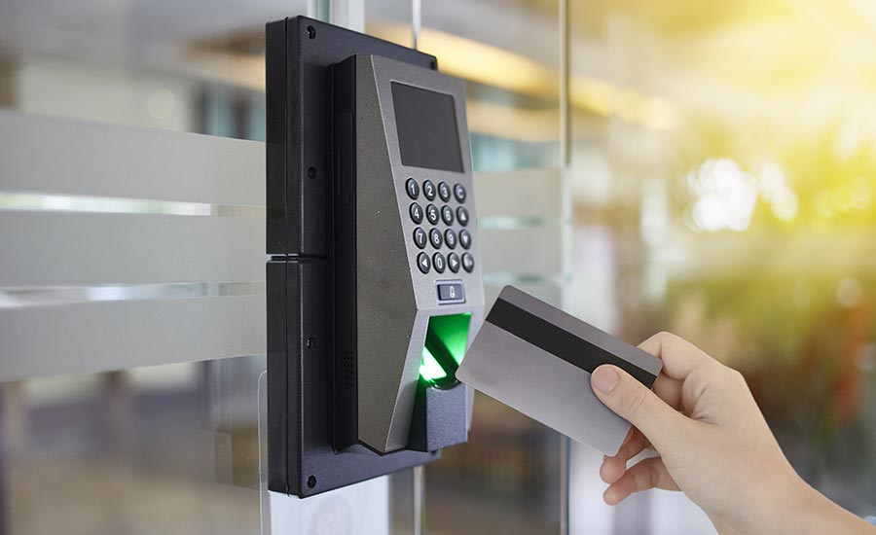
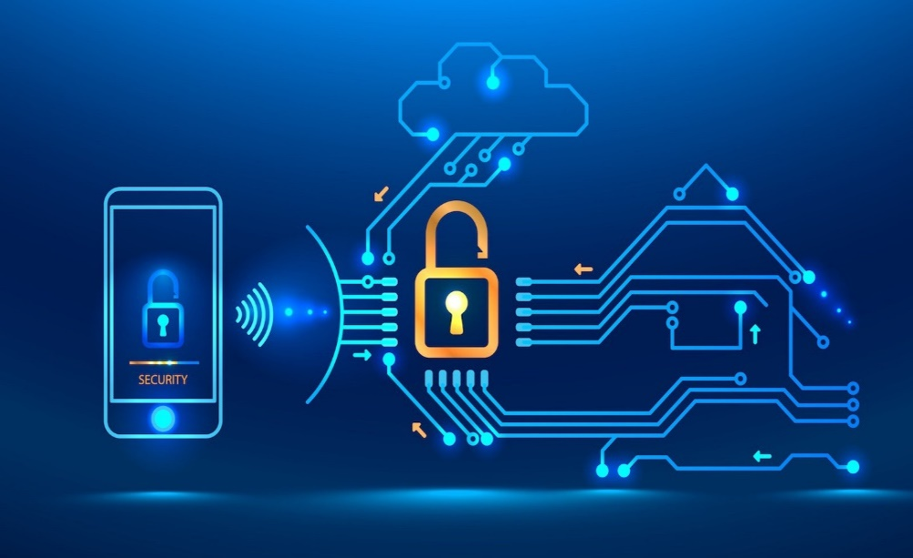
1.1 What is access control
Access control (AC) is the selective restriction of access to a place or a resource.
Access control = access (consume, use) + control (manage, restrict)
Notes:
Access means getting into a building or some place. It also means using some system resource or network resource. Control means regulating such access.
Technically, access control is a security technique. It regulates who can get into what places and who can use what resources.
There are types of access control. One is physical and the other is logical.
Physical access control limits access to campuses, buildings, rooms and physical IT assets.
To achieve physical access control, organizations use electronic access control systems that rely on user credentials, access card readers, auditing and reports to track employee access to restricted locations.
Logical access control limits connections to computer networks, system files and data.
To achieve logical access control, organizations set up login credentials including password, PIN number, biometric scans and security tokens.
In this course, we focus on logical access control.

Slide 5


Traditional Privacy vs. Today’s Public Sharing
Access Control
Public Sharing

Slide 6
1.1 What is access control
There are two types of access control.
Physical access control, e.g., get into buildings, rooms… ;
Logical access control, e.g., connect to computer networks, system files … .
Notes:
Access means getting into a building or some place. It also means using some system resource or network resource. Control means regulating such access.
Technically, access control is a security technique. It regulates who can get into what places and who can use what resources.
There are types of access control. One is physical and the other is logical.
Physical access control limits access to campuses, buildings, rooms and physical IT assets.
To achieve physical access control, organizations use electronic access control systems that rely on user credentials, access card readers, auditing and reports to track employee access to restricted locations.
Logical access control limits connections to computer networks, system files and data.
To achieve logical access control, organizations set up login credentials including password, PIN number, biometric scans and security tokens.
In this course, we focus on logical access control.

Slide 7
1.1 What is access control
Access control techniques typically include two components: authentication and access control models.
Authentication is used to identify and verify users by letting users present a secret to a system. The goal is to have only authorized users access a computer system, a network or a particular service.
Access control models are used to manage and control the behaviour of authorized users by making a set of regulations.
Notes:
In order words, authentication is as a door to control users getting into a system.
Access control models are as policies to regulate authorized users’ behavior in the system.

Slide 8

1.2 Why do we need access control
Organizations have high desirability on their resource security.
Access control is a fundamental technique minimizing security risk to organizations.
Notes:
Security risks could be from various aspects, such as hacking, human error, virus and so on.

Slide 9


1.2 Why do we need access control
Example 1: Yahoo Says 1 Billion User Accounts Were Hacked
https://www.nytimes.com/2016/12/14/technology/yahoo-hack.html
These user accounts include users’ names, date of birth, telephone numbers, encrypted passwords and unencrypted security questions.
Example 2: Equifax Announces Cybersecurity Incident
https://investor.equifax.com/news-and-events/news/2017/09-07-2017-213000628
There was unauthorized access to Equifax’s consumer database impacting 143 million US consumers. The information accessed primarily includes names, social security numbers, birth dates, addresses, driver's license numbers, and even credit card numbers.
Notes:
I give some real-world examples about security risks. These examples show what happened if an organization failed on access control.

Slide 10
2. Authentication

Slide 11
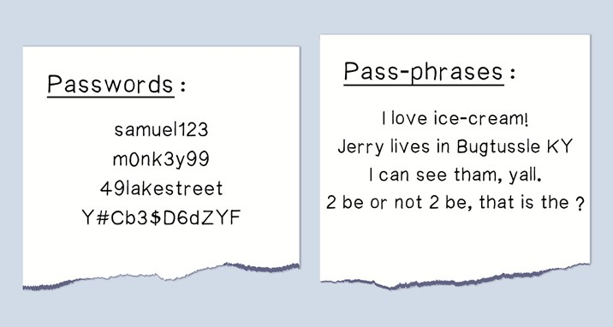
2.1 Password authentication
The idea of password authentication is to present something that a user knows.
The common scheme of password authentication includes: passwords, personal identification numbers (PIN), and pass-phrases.

Slide 12
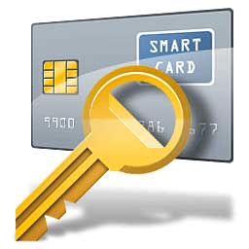
2.2 Token authentication
The idea of token authentication is to present something that a user has.
The common scheme of token authentication is various smart cards.

Slide 13


2.2 Biometric authentication
The idea of biometric authentication is to present something that a user is.
The common scheme of biometric authentication includes: fingerprint, hand geometry, eye iris and so on.

Slide 14
2.2 Comparison of the three authentication methods
Passwords
Tokens
Biometrics
Easy to implement and low cost
Require special device readers
Require special equipment
Need to be memorised
Need to be carried around
Naturally present without taking anything
Susceptible to be guessed
Possible to lose or be stolen
Hard to compromise
Require secure communication channels but can access systems remotely
Accessing only local systems
Accessing only local systems

Slide 15
3. Access control models

Slide 16
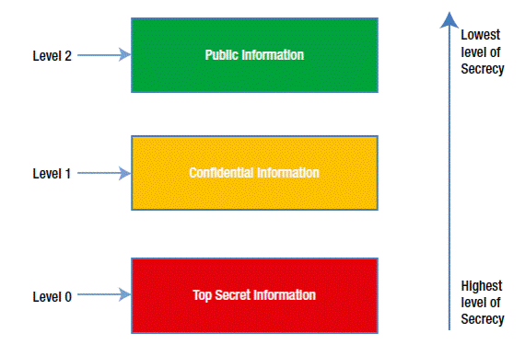
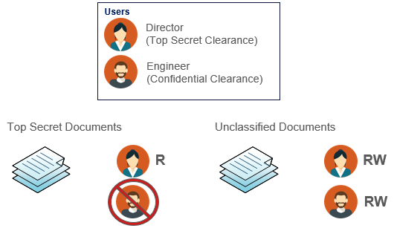
3.1 Mandatory access control
Mandatory access control (MAC) is a hierarchical security model.
In MAC, a central authority sets the rules on who has access to what resources based on the sensitivity of information contained in each resource.
The advantages of MAC include strictness and high security level.
The disadvantage of MAC is high management cost.
Notes:
There are three main types of access control models: mandatory access control model (MAC), discretionary access control model (DAC), and role-based access control model (RBAC).
MAC is the strictest access control model. It takes the control of all level resources.
Access to resources is predefined by an authority and remains unchanged thereafter.
Any other system entities cannot transfer access rights to others.
Because of its strictness, MAC is often used in government and military environments.

Slide 17













3.1 Mandatory access control
Then the MAC model can be described as follows.
users
resources
processes
Top Security
$$u_{1}$$
$$r_{1}$$
$$p_{1}$$
Security
$$u_{2}$$
$$r_{2}$$
$$p_{2}$$
Confidential
$$u_{3}$$
$$r_{3}$$
$$p_{3}$$
Unclassified
$$u_{4}$$
$$r_{4}$$
$$p_{4}$$
Notes:
The most important part is to create the security class and information flow graph.
Then, other entities can be bounded to the graph.

Slide 18
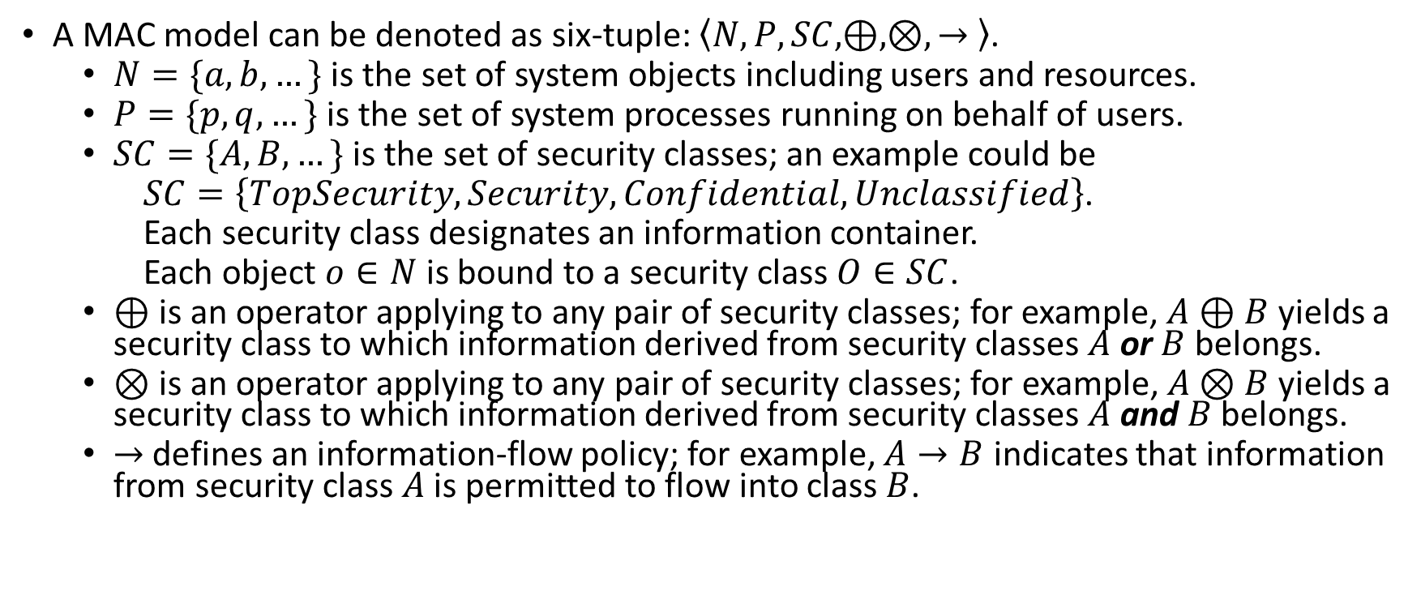
3.1 Mandatory access control
A MAC model can be denoted as six-tuple: $\left\langle N,P,SC,⊕,⊗,→ \right\rangle$.
$N=\{a,b,…\}$ is the set of system objects including users and resources.
$P=\{p,q,…\}$ is the set of system processes running on behalf of users.
$SC=\{A,B,…\}$ is the set of security classes; an example could be
$SC=\left\{TopSecurity,Security,Confidential,Unclassified\right\}$.
Each security class designates an information container.
Each object $o∈N$ is bound to a security class $O∈SC$.
$⊕$is an operator applying to any pair of security classes; for example, $A⊕B$ yields a security class to which information derived from security classes $A$ or $B$ belongs.
$⊗$ is an operator applying to any pair of security classes; for example, $A⊗B$ yields a security class to which information derived from security classes $A$ and $B$ belongs.
$→$ defines an information-flow policy; for example, $A→B$ indicates that information from security class $A$ is permitted to flow into class $B$.
Notes:
In other words, $⊕$ defines which security class has the higher level.
In other words, $⊗$ defines which security class has the lower level.
In other words, $A→B$means that users bounded to class B can access the resources bounded to class A.

Slide 19
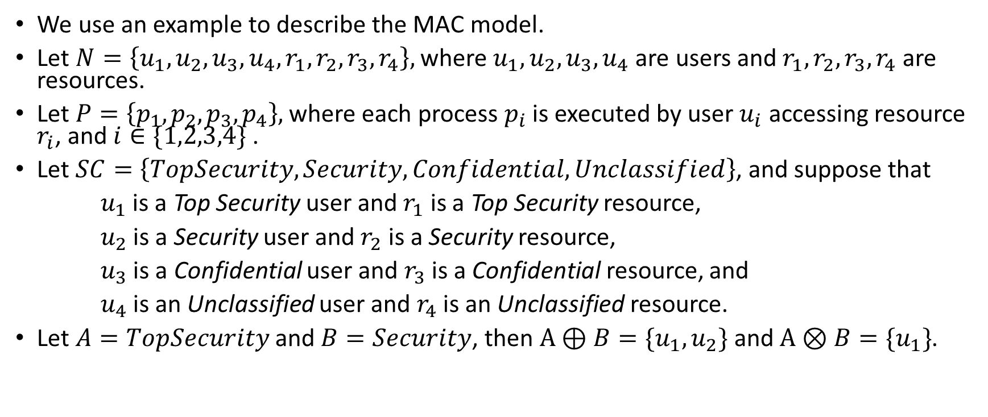
3.1 Mandatory access control
We use an example to describe the MAC model.
Let $N=\left\{u_{1},u_{2},u_{3},u_{4},r_{1},r_{2},r_{3},r_{4}\right\},$ where $u_{1},u_{2},u_{3},u_{4}$are users and $r_{1},r_{2},r_{3},r_{4}$ are resources.
Let $P=\left\{p_{1},p_{2},p_{3},p_{4}\right\},$ where each process $p_{i}$ is executed by user $u_{i}$ accessing resource $r_{i}$, and $i∈\{1,2,3,4\}$ .
Let $SC=\left\{TopSecurity,Security,Confidential,Unclassified\right\}$, and suppose that
$u_{1}$ is a Top Security user and $r_{1}$ is a Top Security resource,
$u_{2}$ is a Security user and $r_{2}$ is a Security resource,
$u_{3}$ is a Confidential user and $r_{3}$ is a Confidential resource, and
$u_{4}$ is an Unclassified user and $r_{4}$ is an Unclassified resource.
Let $A=TopSecurity$ and $B=Security$, then $A⊕B=\{u_{1}, u_{2}\}$ and $A⊗B=\{u_{1}\}$.

Slide 20
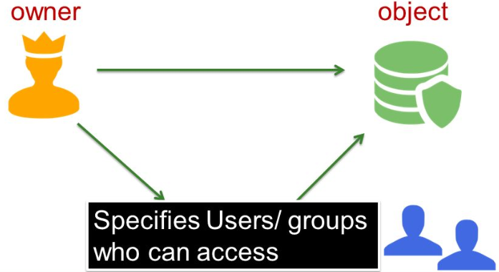
3.2 Discretionary access control
Discretionary access control (DAC) is an owner-centric security model. Each system resource is assigned ownership to one or more entities.
The owner of a resource has complete discretion over who else can access the resource and in what mode access is accomplished.
The advantages of DAC include simplicity, flexibility and ease of implementation.
The disadvantage of DAC is that the propagation of access rights is unbounded and thus access rights may be given to malicious users.

Slide 21
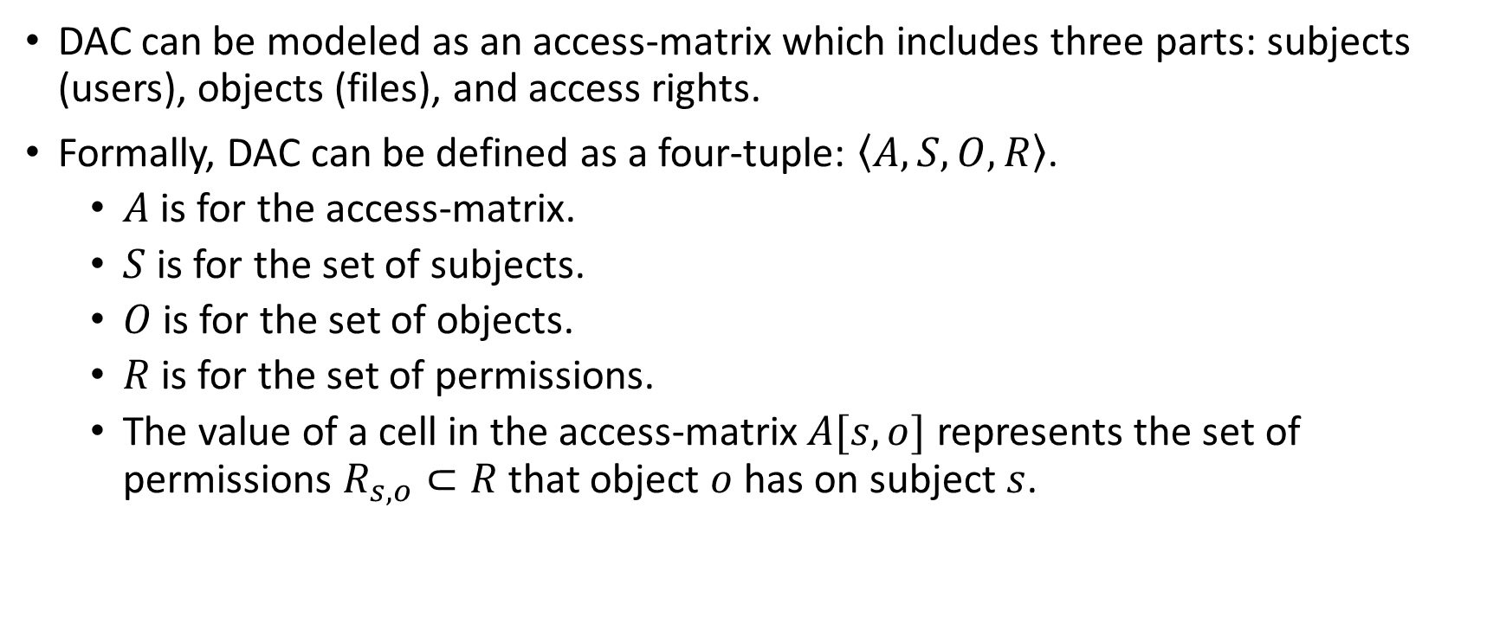
3.2 Discretionary access control
DAC can be modeled as an access-matrix which includes three parts: subjects (users), objects (files), and access rights.
Formally, DAC can be defined as a four-tuple: $\left\langle A,S,O,R\right\rangle$.
$A$ is for the access-matrix.
$S$ is for the set of subjects.
$O$ is for the set of objects.
$R$ is for the set of permissions.
The value of a cell in the access-matrix $A[s,o]$ represents the set of permissions $R_{s,o}⊂R$ that object $o$ has on subject $s$.

Slide 22








3.2 Discretionary access control
We use an example to describe the DAC model.
Let $S=\left\{s_{1},s_{2},s_{3}\right\}$, $O=\left\{o_{1},o_{2},o_{3},o_{4}\right\}$, $R=\left\{Read,Write,Execute,Append\right\}$
In the following access-matrix, for example, subject $s_{1}$can Read and Write object $o_{1}$, but for object $o_{4}$, subject $s_{1}$can only Read it.
$$o_{1}$$
$$o_{2}$$
$$o_{3}$$
$$o_{4}$$
$$s_{1}$$
Read, Write | Execute |  | Read
 |  | Read, Execute
Append |  | Append | Read, Write
$$s_{2}$$
$$s_{3}$$

Slide 23








3.2 Discretionary access control
In an access-matrix, an entire row is referred to as the capability of a subject.
A column is referred to an access-control list (ACL) of an object.
$$o_{1}$$
$$o_{2}$$
$$o_{3}$$
$$o_{4}$$
$$s_{1}$$
Read, Write | Execute |  | Read
 |  | Read, Execute
Append |  | Append | Read, Write
$$row$$
$$s_{2}$$
$$s_{3}$$
Column
Notes:
In other words, an entire row shows what a subject (user) can do in a system.
In other words, a column gives a list about who can use an object.

Slide 24
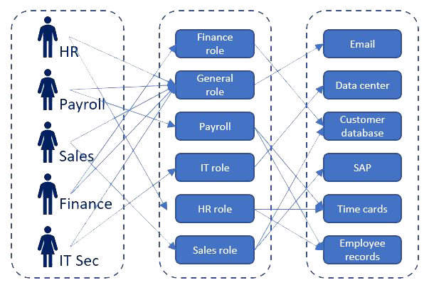
3.3 Role-based access control
Role-based access control (RBAC) regulates access to resources based on the role of acting subjects, such as users and programme agents.
A role is an abstraction that encapsulates a set of responsibilities along with corresponding allowable operations.
RBAC is an alternative of MAC and DAC. It is easer to manage than MAC and securer than DAC.
Notes:
In RBAC, access rights are assigned to roles instead of entities. Each user is then assigned to a particular role.

Slide 25
3.3 Role-based access control
This is a RBAC model example.
The assignments are represented as links.
Users
Roles
Permissions

Slide 26
4. Threats to access control

Slide 27

4.1 Insider attacks
An insider attack is a malicious attack against a network or computer system by a person with authorised system access.
Insiders that perform attacks have a distinct advantage over external attackers because they have authorized system access and also may be familiar with network architecture and system policies/procedures.
Inside attackers are typically more dangerous than external attackers because many organisations focus on protection from external attacks.
Notes:
Generally, there are three major threats to access control. The first one is insider attack.

Slide 28
4.1 Insider attacks
Ninety percent of organisations feel vulnerable to insider attacks.
The main enabling risk factors include: too many users with excessive access privileges (37%), an increasing number of devices with access to sensitive data (36%), and the increasing complexity of information technology (35%).
Fifty-three percent of organisations have confirmed insider attacks against their organization in the previous 12 months.
Organisations are shifting their focus to detection of insider threats (64%), and the use of user behavior monitoring is accelerating.
The vast majority of organisations (86%) already have or are building an insider threat program.
Notes:
This is an insider threat report started by a survey company. Here are some major results.

Slide 29

4.1 Insider attacks
Counter-measures on insider attacks:
separation of duties, e.g., limit the privileges of each user,
enhancing access management, e.g., at least two users with the same privileges can access sensitive information,
job rotation,
deployment of insider threat detection techniques, e.g., intrusion detection systems,
…

Slide 30
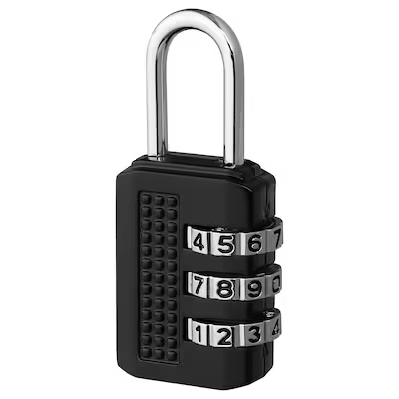
4.2 Brute force attacks
A brute force attack is an attempt to crack a password and/or username to access authorised information.
A brute force attack is typically based on a trial and error approach which is expected to guess correctly eventually.
Brute force attack is an old attack method, but it's still effective and popular with hackers. One of the popular brute force attacks is dictionary attack.

Slide 31
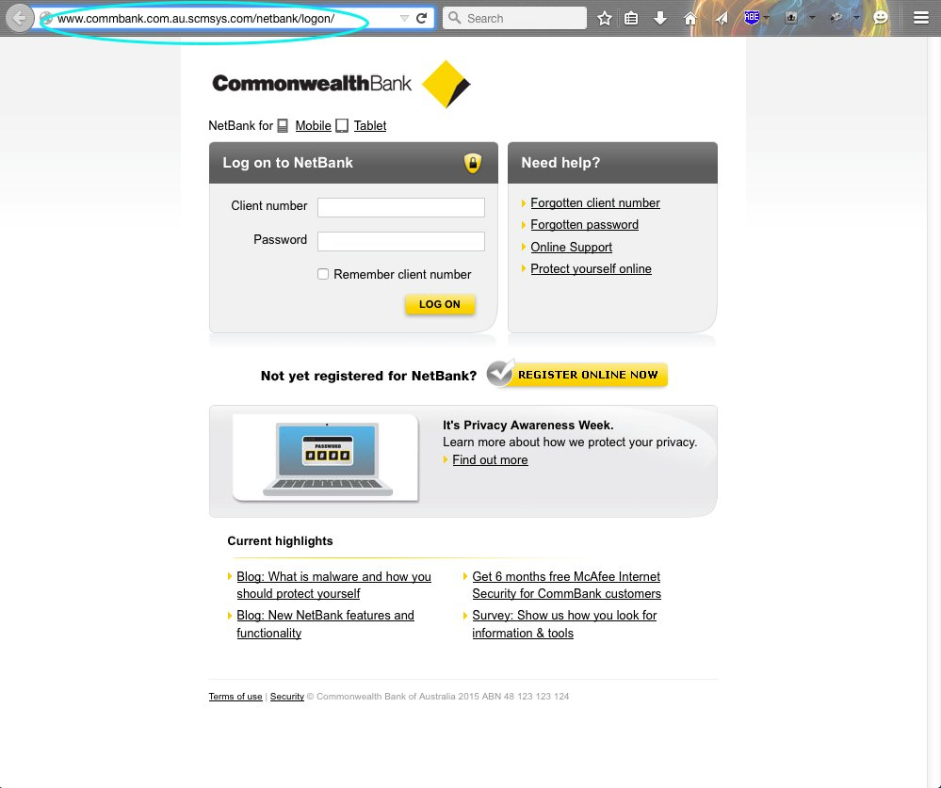
4.3 Login spoofing
Login spoofing is a technique used to steal users’ password.
The user is presented with an ordinary looking login prompt for username and password, which is actually a malicious program under the control of the attacker.
When the username and password are entered, this information is passed along to the attacker.
Notes:
This picture looks very like the Commonwealth Bank login page. But actually, when you check the this address. That’s not Commonwealth Bank.

Slide 32
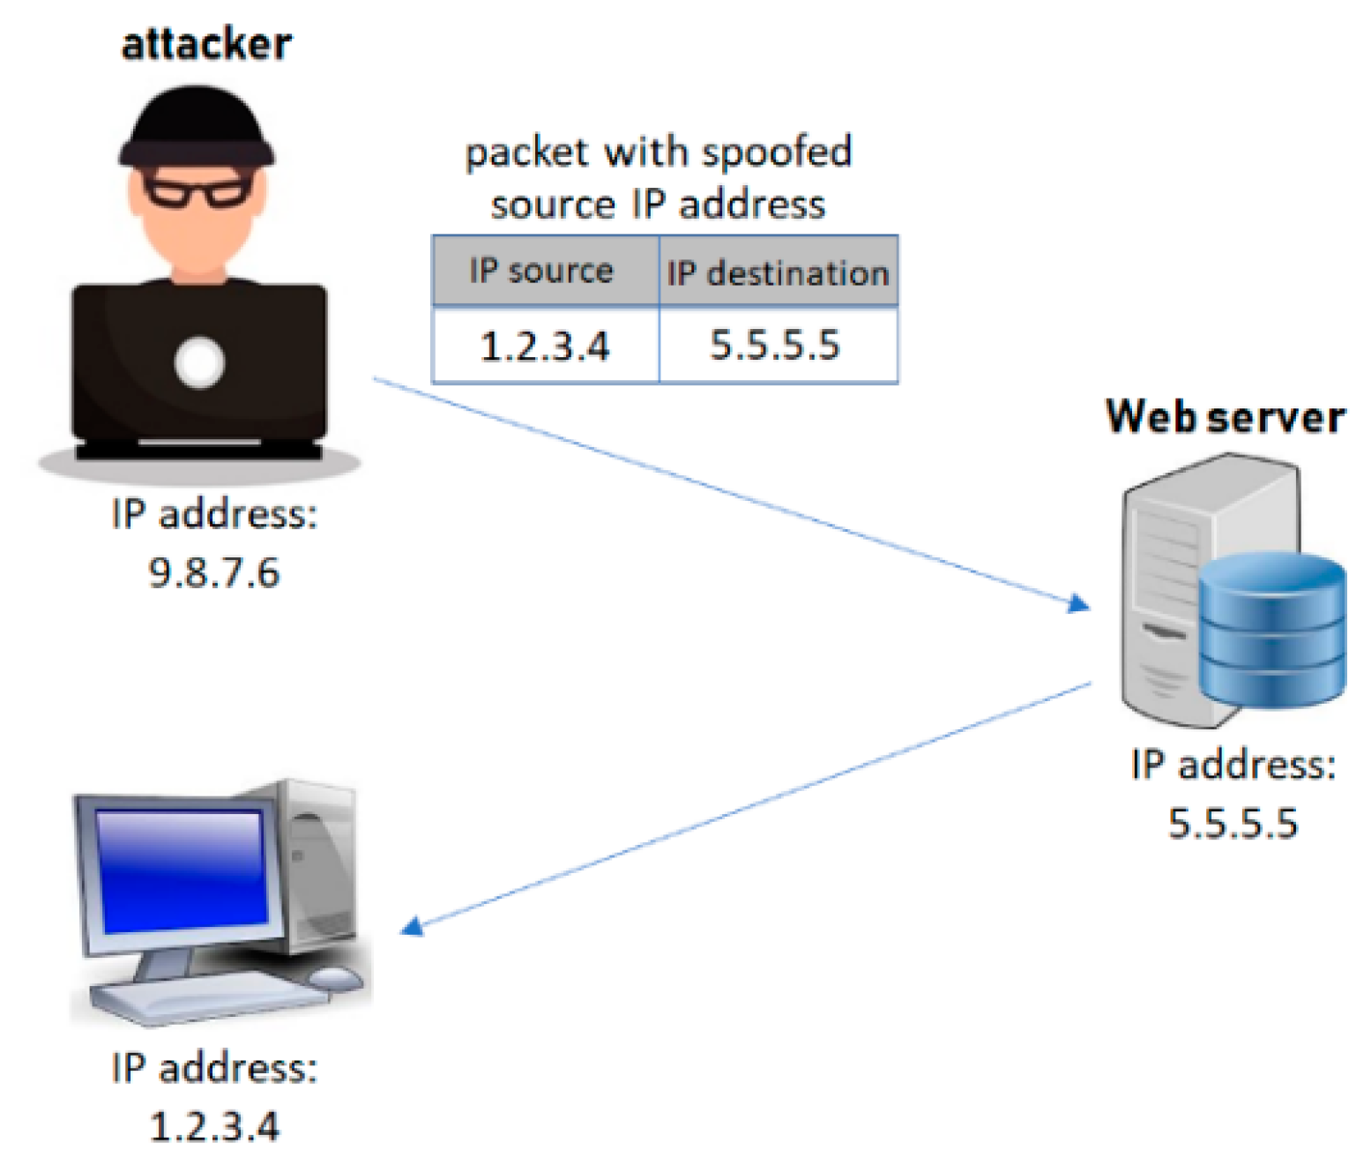
4.3 Other spoofing examples
IP spoofing: IP spoofing is to create packets which have a modified source IP address in order to either hide the identity of the sender, to pretend another computer system, or both.
Notes:
This picture looks very like the Commonwealth Bank login page. But actually, when you check the this address. That’s not Commonwealth Bank.

Slide 33
5. Encryption for privacy protection

Slide 34
5.1 Encryption
Encryption is the main stream methods for privacy protection.
Build on rigorous foundations. E.g., number theory, group theory.
Tested by time.

Slide 35
5.1 Encryption mechanism
Every information is an integer (mapping information into number domain)
Operations on the original number to obtain the ciphertext
It is easy to decrypt the ciphertext with the key, but very hard to do so without the key

Slide 36
5.2 Cryptography brief history
Ancient cryptography (substitution)
Modern cryptography (number theory, group theory, …)
Multiple party secure computing (e.g., data aggregation in federated learning, millionaire problem, …)
Zero knowledge proof
Attribute Based Encryption (multiple receivers)
Cryptography serves privacy

Slide 37

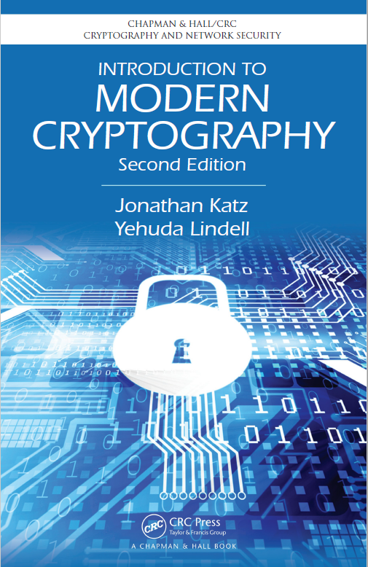
5.3 Many resources for cryptography
Classic Textbook

Slide 38
6. Large Language Models (LLM)

Slide 39
Security & privacy of LLM
Large Language Model
Language, language + image, …
Problems of LLM
- black-box (lack of explanation)
Hallucination (technical problem?)
Generate illegal content
…

Slide 40
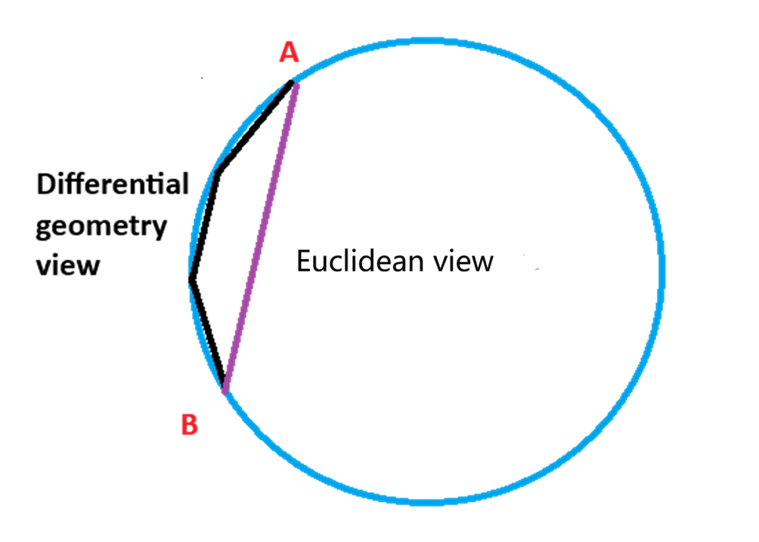
Security & privacy of LLM
Causes of the problems of LLM
AI generated datasets as input (the percentage increases, ~3%)
LLMs are statistical models
Attention calculation is linear based (the problem is the real LLM is linear??)

Slide 41

Thank you & Questions http://www.uts.edu.au/syu email: shui.yu@uts.edu.au

